Slide 1
Research proposal
Lottery Ticket sub Networks : Gradient Pruning
Motivation:
Latest methods based on Lottery tickets (LTs) like Sparse Model Soup ,Instant Soup pruning ,
lottery pools , etc are able to find accurate and sparse sub networks that match the
performance of dense networks. These methods use less training and lower inference cost
when compared to original Lottery Tickets.
These LT algorithms use pruning of weights based on Magnitude . Neural network
updation of weights is calculated both from learning rate and gradients . Can we obtain
best LTs using only gradients pruning instead of Weight pruning?
We propose to investigate whether gradient based pruning of networks can also
give best sub networks for the latest LTs algorithms.

Slide 2
Methodology:
Datasets:MNIST,CIFAR10
Networks:Lenet5,AlexNet,Conv6,Conv8,VGG19,Resnet18
Procedure:
For each network model the following steps are carried out on each dataset
Sparse Model Soup:
1.Using Weight pruning get lottery ticket sub network s using latest LTH : Sparse Model soups
2.Using gradients pruning get lottery ticket sub network s using latest LTH : Sparse Model soups
2.Compare performance of LTs from both methods of pruning.

Slide 3
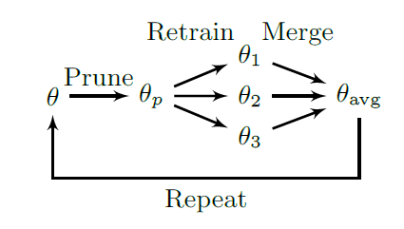
1.Weights pruning:
Input: Pretrained model θ
Output: Sparse model soup
for each prune-retrain cycle do
Prune θ(magnitude based)
for i ← 1 to m do
θ_{i} ← θ
Retrain θ_{i} with specific hyper parameters
end for
θ ←Merge(θ₁, . . . , θ_{m})
end for
return θ
2.Gradients Pruning:
Input: Pretrained model θ
Output: Sparse model soup
for each prune-retrain cycle do
Prune θ(gradient based)
for i ← 1 to m do
θ_{i} ← θ
Retrain θ_{i} with specific hyper parameters
end for
θ ←Merge(θ₁, . . . , θ_{m})
end for
return θ

Slide 4
Research Plan:
Three members will implement :
1.Obtain weight pruned optimal networks using Sparse Model soup on MNIST dataset.
2.Obtain gradient pruned optimal networks using Sparse Model soup on MNIST dataset.
Three members will implement :
1.Obtain weight pruned optimal networks using Sparse Model soup on CIFAR dataset.
2.Obtain gradient pruned optimal networks using Sparse Model soup on CIFAR dataset
Team Work:
From the above work analyse performance for original network, optimal
Sub network , with weight pruning and gradient pruning.
Feasibility :
1.Can be implemented for Small datasets.
2.Tensorflow library will be used for implementation.

